Slide 1

Shell Bootcamp 2024 3 Reflections for Week #1
Siddharth Mandal
Date : 30-Aug-2024

Slide 2

About Me
Keep people near you who care for you, not for whom you must work hard.

Slide 3

My learnings from this week!

Slide 4
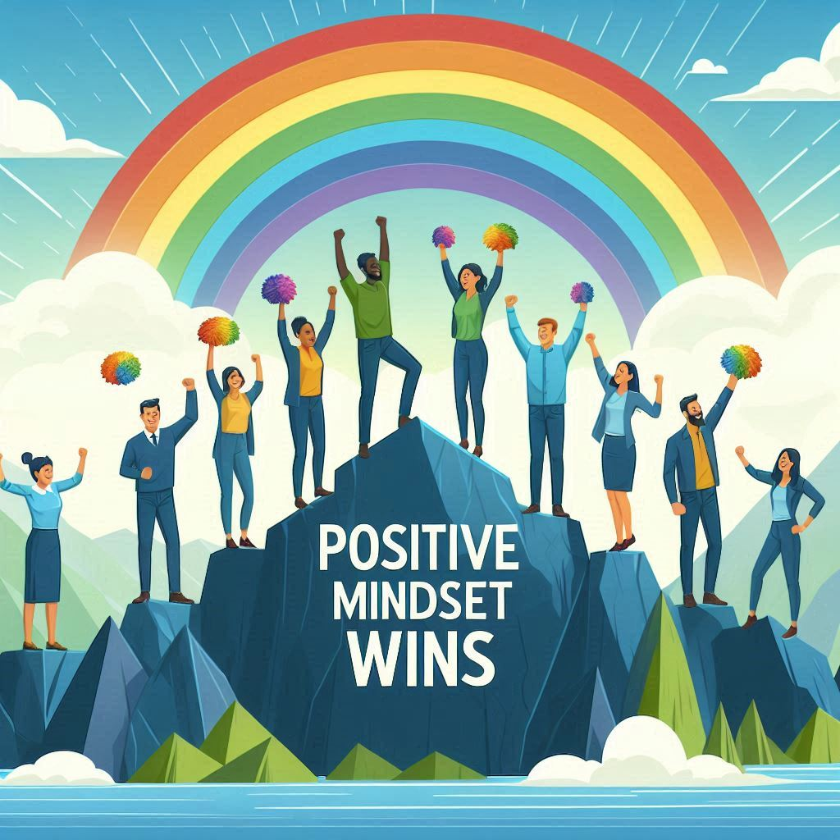
Learning day 1 | My takeaways
Please share (in your own words) details of the learning.
Attitude and mindset
An attitude is a mindset or perspective that influences how a person behaves. It can also refer to the way someone holds or positions their body or its parts.
Your mindset is a set of beliefs that shape how you make sense of the world and yourself. It influences how you think, feel, and behave in any given situation.
In a high-risk sector like SHELL’s, it is very important to plan, coordinate and interact well with every individual to ensure safety of every individual.

Slide 5
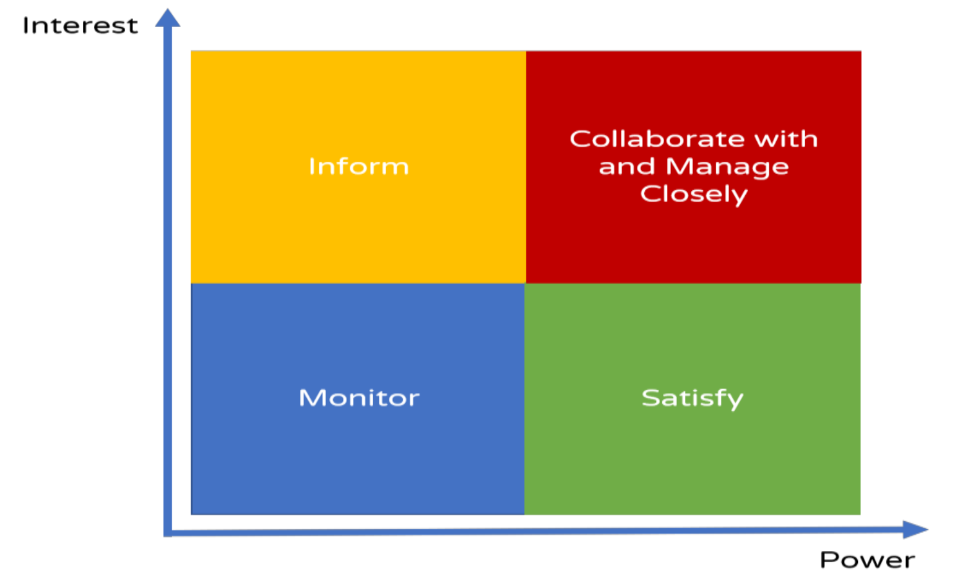
Learning day 2 | My takeaways
Please share (in your own words) details of the learning.
Stakeholder
Stakeholder mapping – High power high interest, high power low interest, low power high interest, low power low interest
It is very important in a big company like SHELL to understand the key stakeholders and accommodate in the power interest grid to identify how significant they are in the decision making and daily functioning towards success.

Slide 6

Learning day 3 | My takeaways
Please share (in your own words) details of the learning.
Elements of an effective presentation
Things to keep in mind – Audience analysis, content, design, delivery
An energy company of the size of SHELL that operates in more than 70 countries needs to present itself for various deals, interactions with organisations from various countries and for various needs, so presentation skills have to be of highest importance

Slide 7
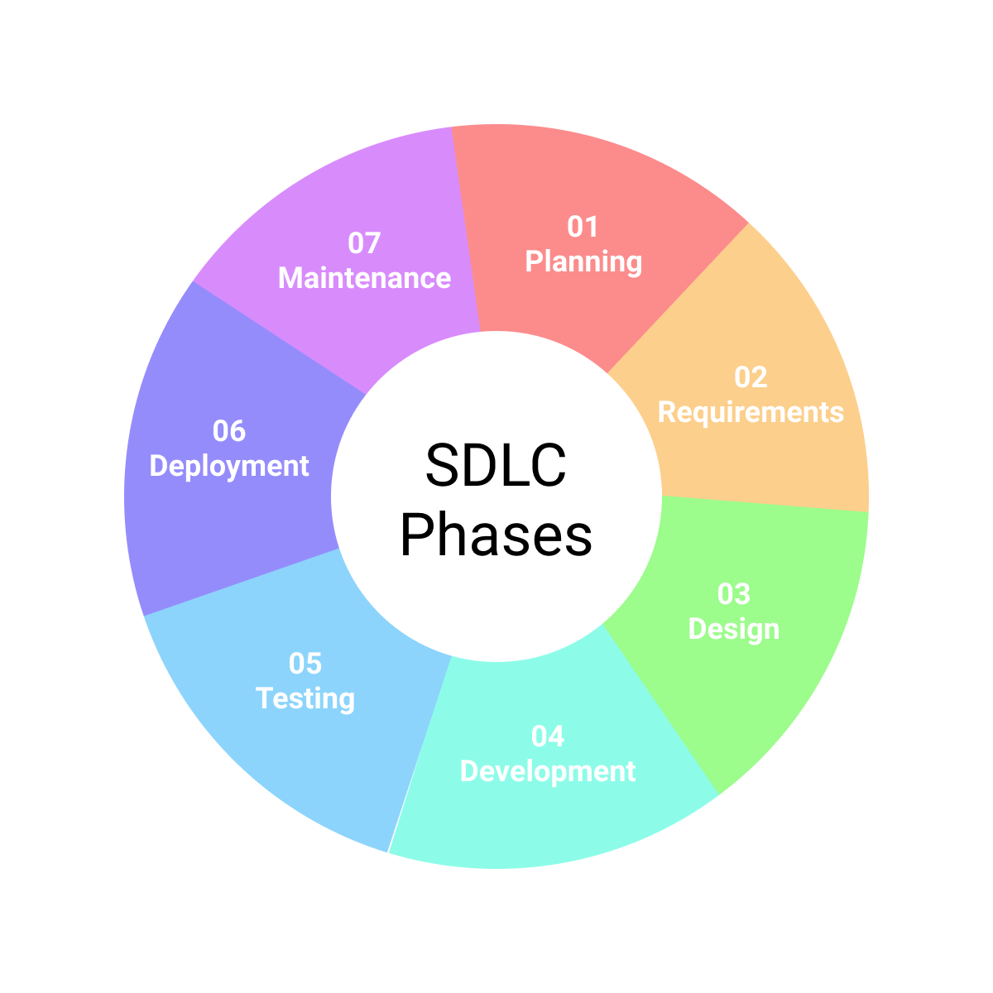
Learning day 4 | My takeaways
Please share (in your own words) details of the learning.
SDLC
The Software Development Life Cycle (SDLC) is a structured process used to design, develop, test, and maintain high-quality software. It consists of several phases, including planning, analysis, design, implementation, testing, deployment, and maintenance. Each phase plays a crucial role in ensuring the software meets customer requirements, is delivered on time, and stays within budget.
Shell utilizes the Software Development Life Cycle (SDLC) to streamline its software projects, ensuring high-quality and efficient development. By following SDLC phases—planning, analysis, design, implementation, testing, deployment, and maintenance—Shell can systematically address project requirements, reduce risks, and enhance software reliability. This structured approach helps Shell deliver robust software solutions that support its operations and strategic goals.

Slide 8
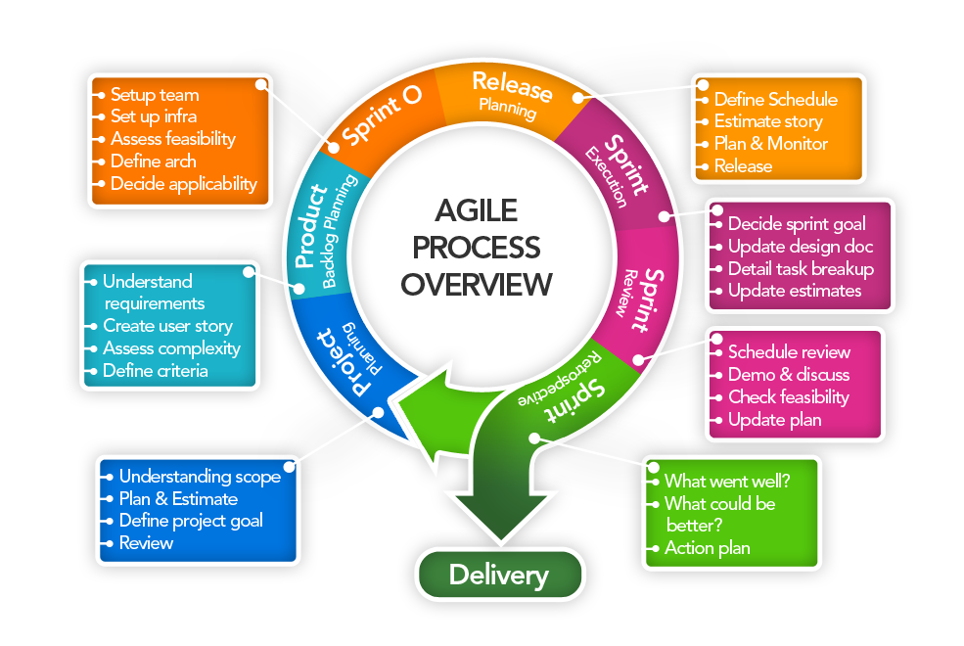
Learning day 5 | My takeaways
Please share (in your own words) details of the learning.
Agile on Azure devops
Agile is a methodology that emphasizes iterative development, collaboration, and flexibility in software projects. Azure DevOps is a suite of tools provided by Microsoft that supports Agile practices by offering services for planning, developing, testing, and deploying software. Together, Agile and Azure DevOps enable teams to deliver high-quality software efficiently and continuously, adapting to changes and improving through regular feedback.
Shell leverages Agile and Azure DevOps to enhance its software development processes. By adopting Agile methodologies, Shell ensures flexibility and continuous improvement in its projects. Azure DevOps provides a suite of tools that support Agile practices, including Azure Boards for project tracking, Azure Repos for version control, and Azure Pipelines for continuous integration and delivery. This combination allows Shell to efficiently manage and deliver high-quality software solutions, adapt to changing requirements, and maintain a competitive edge in the energy sector.

Slide 9

Relevance of learnings for my organization

Slide 10

Learning day 1 | Relevance for Shell
How I feel Shell implements the right attitude and mindset
Shell implements the right attitude and mindset by fostering a culture of innovation, collaboration, and continuous improvement. They prioritize leadership development, encouraging growth and adaptability among employees. Shell also emphasizes the importance of resilience and problem-solving, ensuring that teams are equipped to handle challenges effectively. By promoting open communication and a customer-focused approach, Shell maintains strong relationships with stakeholders and drives sustainable success
How I feel Shell benefits from the right attitude and mindset
Having the right attitude and mindset can greatly benefit a large energy company like Shell by fostering innovation, enhancing teamwork, and improving leadership. It encourages adaptability, resilience, and effective problem-solving, which are crucial in navigating the challenges of the energy sector. Additionally, a customer-focused mindset helps build strong relationships with clients and stakeholders, ensuring long-term success.

Slide 11
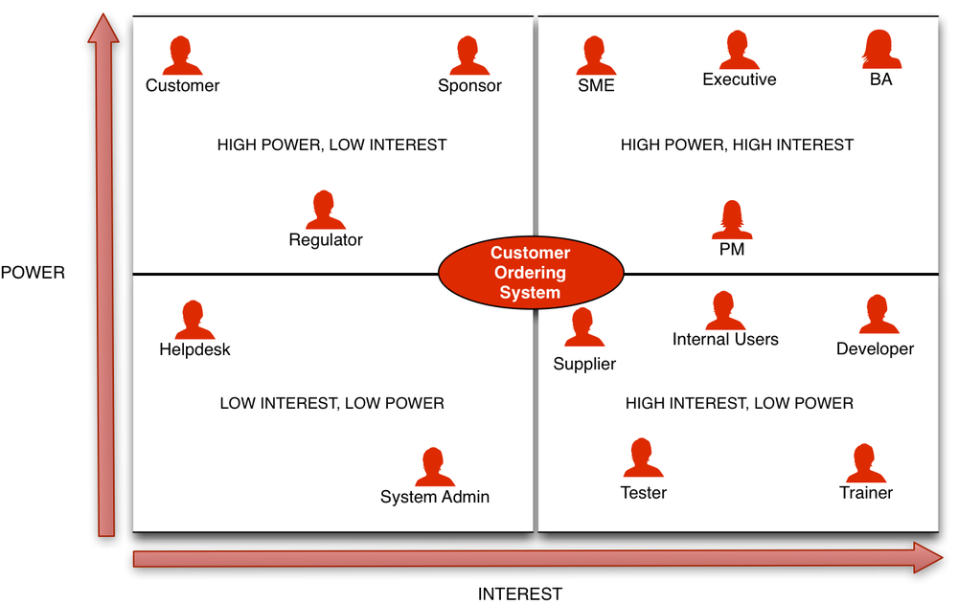
Learning day 2 | Relevance for Shell
How I feel Shell implements stakeholder mapping
Shell implements stakeholder mapping by actively engaging with various stakeholders, including employees, customers, investors, and local communities. They use structured frameworks and policies to ensure continuous and meaningful interactions. This approach helps Shell understand stakeholder needs, address concerns, and incorporate feedback into their decision-making processes, ultimately supporting their commercial, environmental, and social objectives.
How I feel Shell benefits from stakeholder mapping
Shell benefits from stakeholder mapping by gaining a comprehensive understanding of the needs and concerns of various stakeholders, including employees, customers, investors, and local communities. This insight allows Shell to make informed decisions, enhance communication, and build stronger relationships. Effective stakeholder mapping helps Shell mitigate risks, improve project efficiency, and ensure that their operations align with both commercial and social objectives.

Slide 12
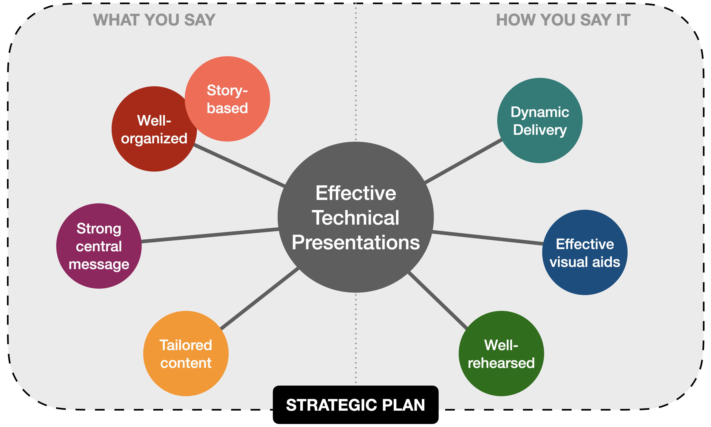
Learning day 3 | Relevance for Shell
How I feel Shell implements effective presentation
Shell implements effective presentation skills by providing comprehensive training programs and resources for employees. These programs focus on enhancing communication techniques, audience engagement, and the use of visual aids. Shell encourages regular practice and feedback sessions to help employees refine their presentation abilities. By fostering a culture of continuous improvement and professional development, Shell ensures that its teams can deliver clear, impactful presentations that effectively convey information and drive business success.
How I feel Shell benefits from effective presentation
Shell benefits from effective presentation skills by enhancing communication and ensuring that key messages are conveyed clearly and persuasively. This leads to better decision-making, stronger stakeholder relationships, and more successful project outcomes. Effective presentations also boost employee confidence and collaboration, fostering a culture of continuous improvement and innovation.

Slide 13
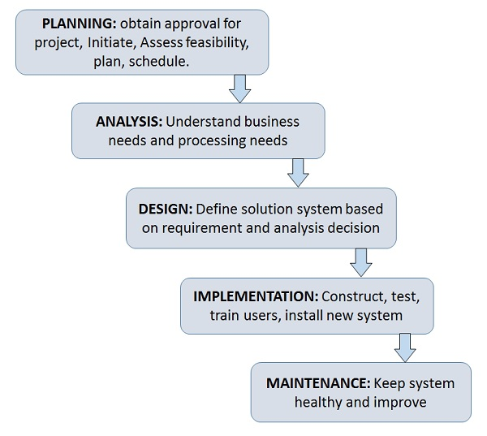
Learning day 4 | Relevance for Shell
How I feel Shell implements SDLC
Shell implements the Software Development Life Cycle (SDLC) by following a structured approach that includes planning, analysis, design, implementation, testing, deployment, and maintenance. This ensures that their software projects are well-managed, meet quality standards, and align with business objectives, ultimately supporting efficient and effective operations.
How I feel Shell benefits from SDLC
Shell benefits from implementing the Software Development Life Cycle (SDLC) by ensuring that their software projects are systematically managed and aligned with business goals. This structured approach enhances the quality and reliability of their software, reduces risks, and improves efficiency. Ultimately, it supports Shell's operational effectiveness and helps them deliver robust, high-quality software solutions that meet stakeholder needs.

Slide 14
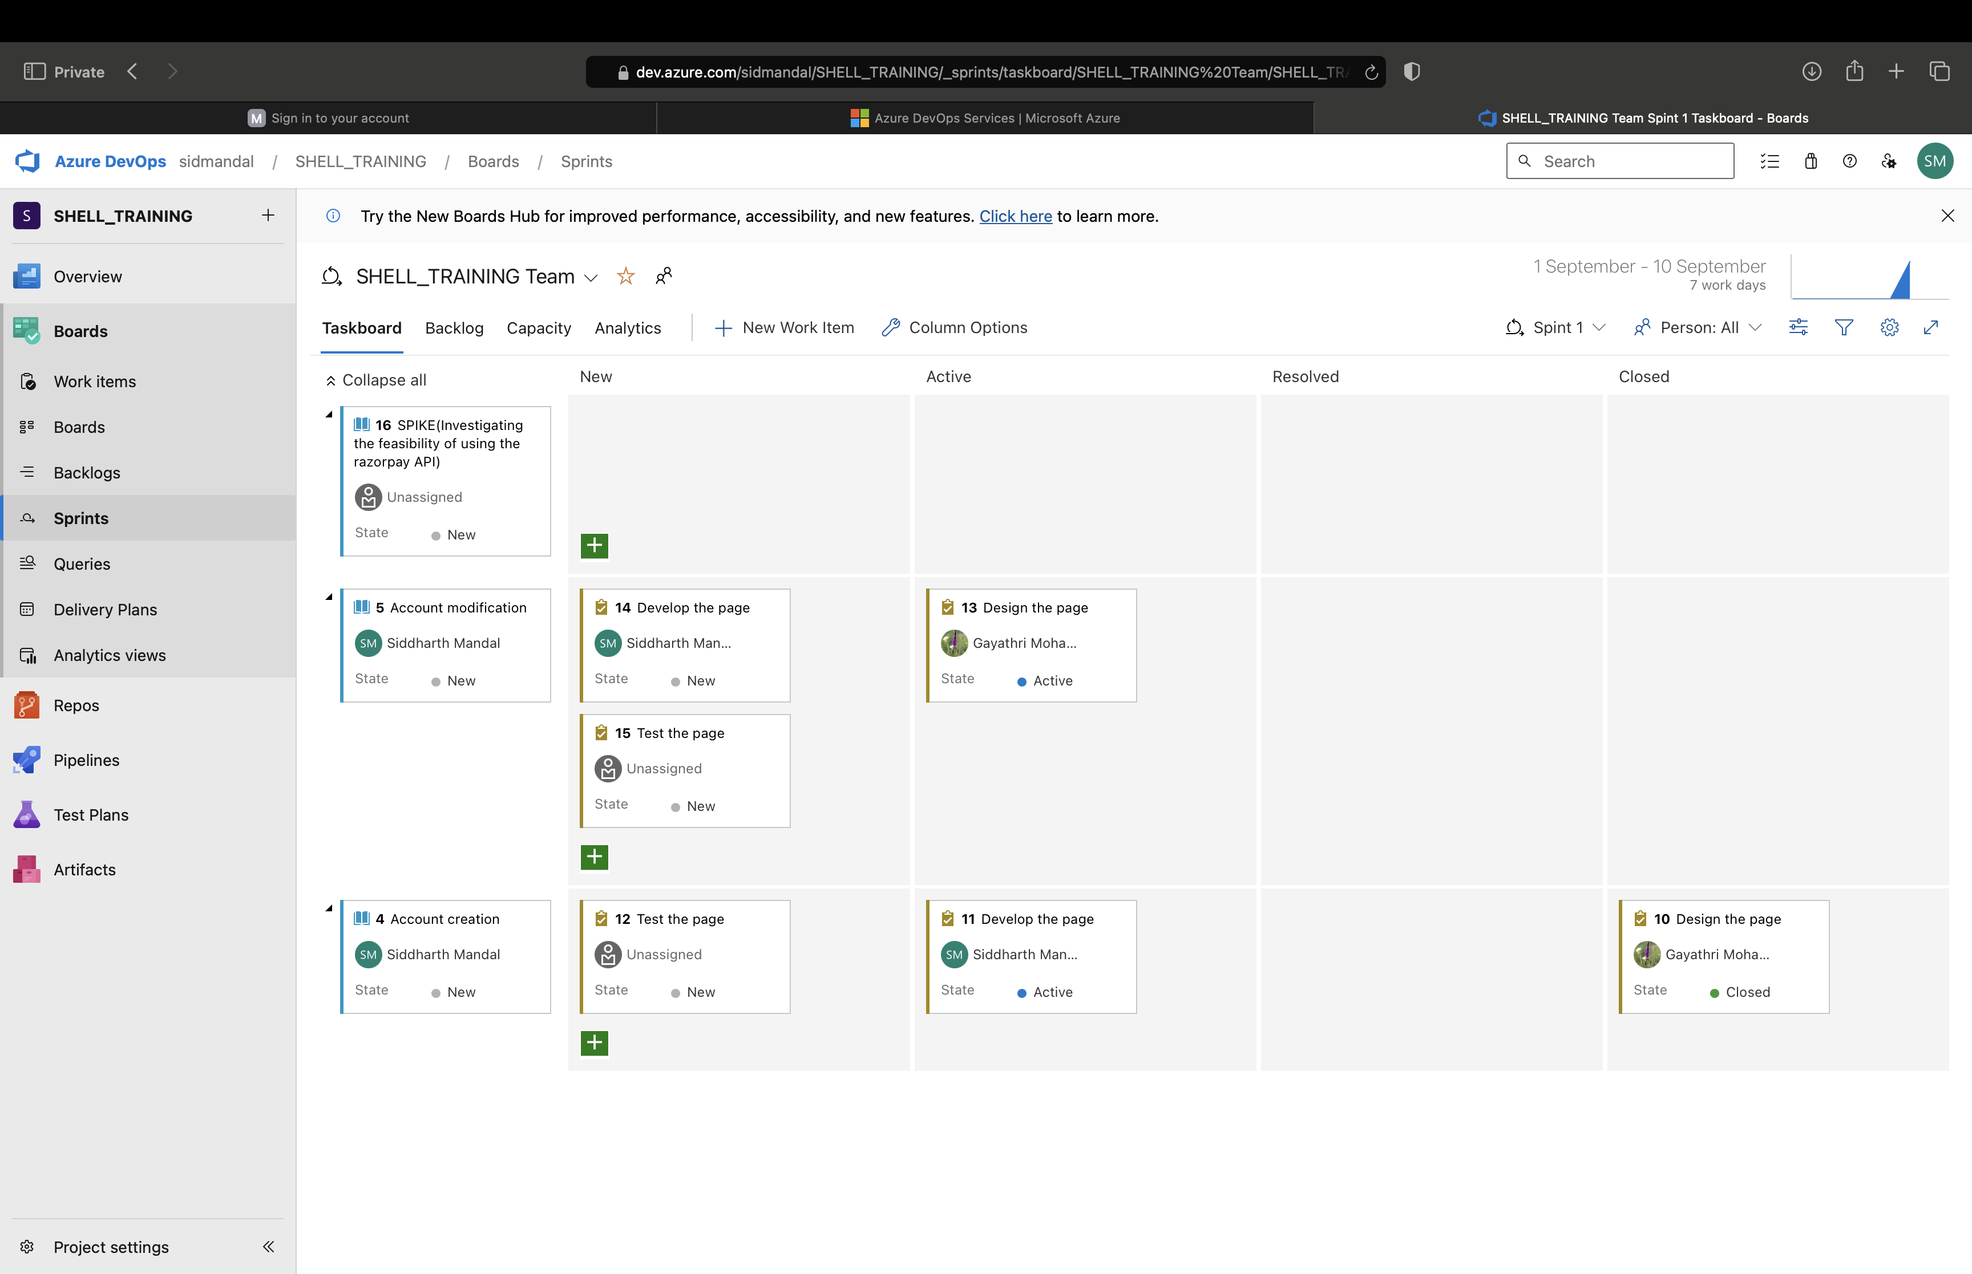
Learning day 5 | Relevance for Shell
How I feel Shell implements agile
Shell implements Agile methodologies through its "Edge" framework, which blends Agile project delivery with Scrum and DevOps practices. This approach allows Shell to achieve continuous delivery and iterative development while retaining some traditional Waterfall elements for projects that require predictability and control. By using Agile, Shell can quickly adapt to changing requirements, enhance collaboration, and improve project outcomes.
How I feel Shell benefits from agile
Shell benefits from implementing Agile methodologies by enhancing flexibility, improving collaboration, and accelerating project delivery. Agile allows Shell to quickly adapt to changing requirements and market conditions, ensuring that projects remain aligned with business goals. This iterative approach also fosters continuous improvement and innovation, leading to higher-quality outcomes and increased efficiency.

Slide 15

Challenges in implementing learning

Slide 16
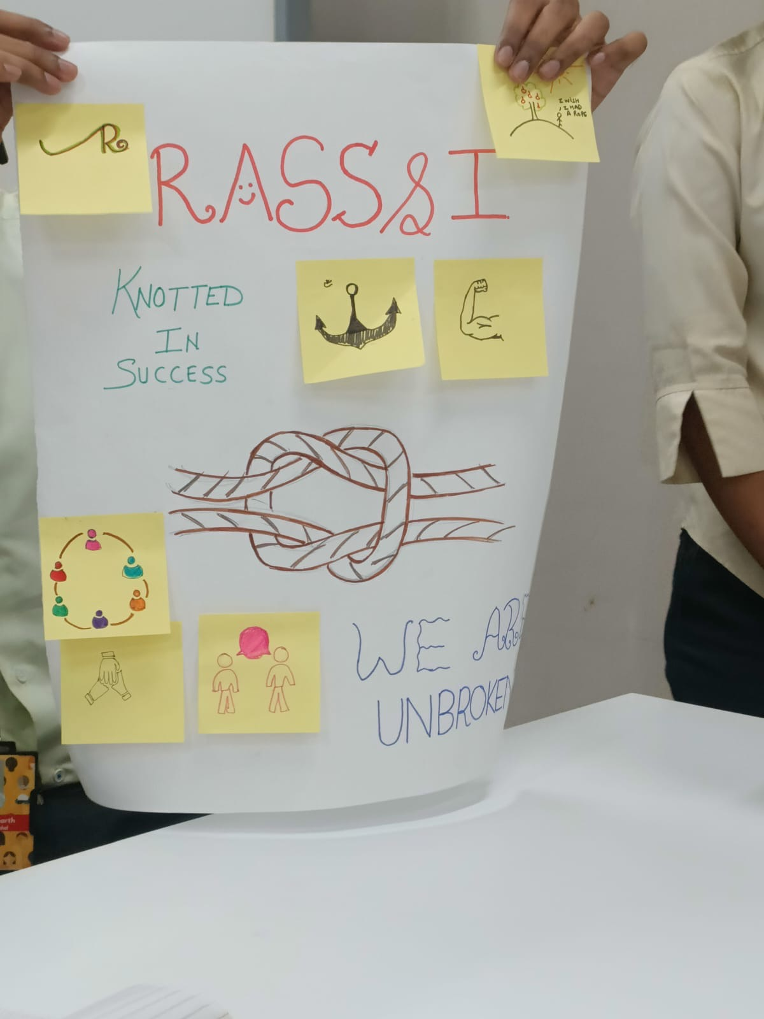
Challenge faced while implementing Learning 1
Adopting the right attitude and mindset can be challenging due to several factors. Self-doubt and fear of failure often hinder progress, making it difficult to stay positive and motivated. External pressures and societal expectations can also create stress, leading to a negative outlook. Additionally, past experiences and ingrained habits can be hard to overcome, requiring significant effort and persistence to change. Developing a growth mindset involves continuous self-reflection, resilience, and the willingness to embrace change and learn from setbacks.
Github: https://github.com/smandalsid/SHELL_TRAINING

Slide 17
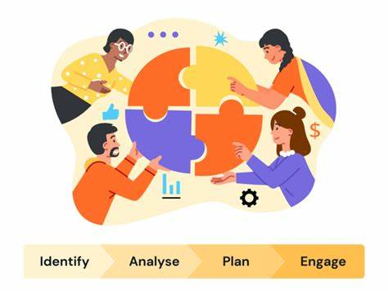
Challenge faced while implementing Learning 2
Identifying stakeholders can be challenging due to several factors. Complex organizational structures often obscure who the key decision-makers are. Diverse interests and priorities among potential stakeholders can make it difficult to determine who has the most influence or investment in a project. Additionally, communication barriers and lack of transparency can hinder the identification process, as not all stakeholders may be immediately visible or forthcoming about their roles and interests. Effective stakeholder identification requires thorough research, clear communication, and often, iterative engagement to ensure all relevant parties are recognized and involved.
Github: https://github.com/smandalsid/SHELL_TRAINING

Slide 18
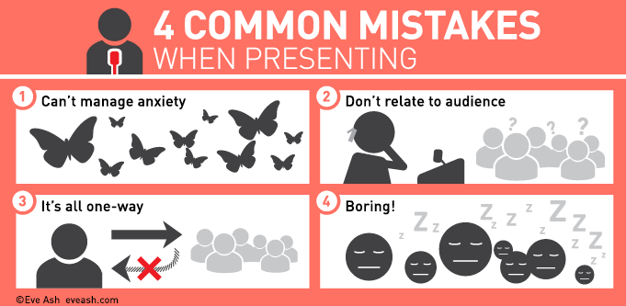
Challenge faced while implementing Learning 3
Giving a presentation can be challenging due to several factors. Nervousness and anxiety often affect speakers, making it difficult to communicate clearly and confidently. Engaging the audience is another challenge, as maintaining their interest and attention requires effective storytelling and interactive elements. Additionally, technical issues such as malfunctioning equipment or software glitches can disrupt the flow of the presentation. Preparing thoroughly, practicing regularly, and having backup plans can help mitigate these challenges and ensure a smoother presentation experience.
Github: https://github.com/smandalsid/SHELL_TRAINING

Slide 19
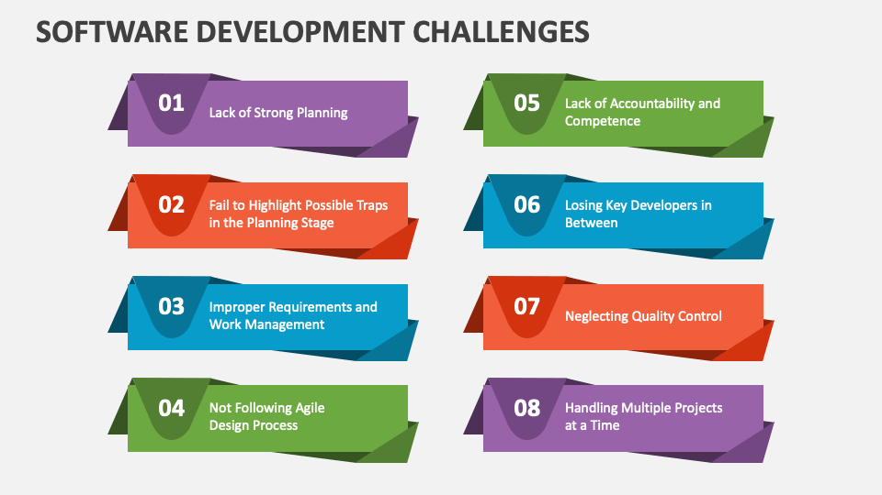
Challenge faced while implementing Learning 4
Understanding the Software Development Life Cycle (SDLC) can be challenging due to its complexity and the need for a comprehensive grasp of various phases. Each phase, from planning and analysis to design, implementation, testing, deployment, and maintenance, requires specific skills and knowledge. Additionally, aligning the SDLC with business goals, managing stakeholder expectations, and adapting to changing requirements can add layers of difficulty. Effective communication and collaboration among team members are crucial, yet often challenging, to ensure a smooth and successful development process.
Github: https://github.com/smandalsid/SHELL_TRAINING

Slide 20
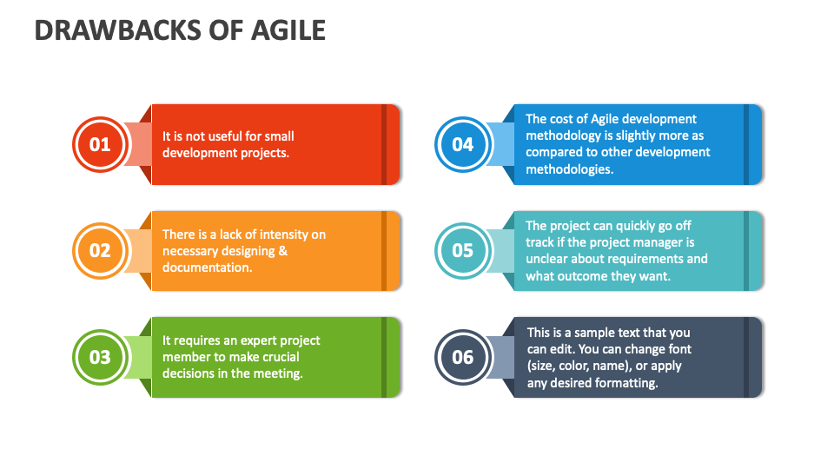
Challenge faced while implementing Learning 5
The Agile model, while flexible and adaptive, presents several challenges. One major issue is managing frequent changes, which can lead to scope creep and affect project timelines. Ensuring consistent communication and collaboration among team members is crucial but can be difficult, especially in distributed teams. Additionally, maintaining a balance between speed and quality can be tricky, as the iterative nature of Agile requires continuous testing and integration. Lastly, aligning the Agile approach with traditional business processes and stakeholder expectations can sometimes create friction and require significant adjustments.
Github: https://github.com/smandalsid/SHELL_TRAINING

Slide 21

Action Plan

Slide 22
My Action Plan for this Week
Actions
Timeline
Status
Improve on speaking, presentation, etiquettes, BA, Agile, SDLC, Testing, DBMS
Revise the concepts of speaking, presentation, etiquettes, BA and agile in the weekend and for the upcoming week go through testing and DBMS
Completed soft skill techniques and looking forward for testing and DBMS.

Slide 23

Learning is also Fun!

Slide 24
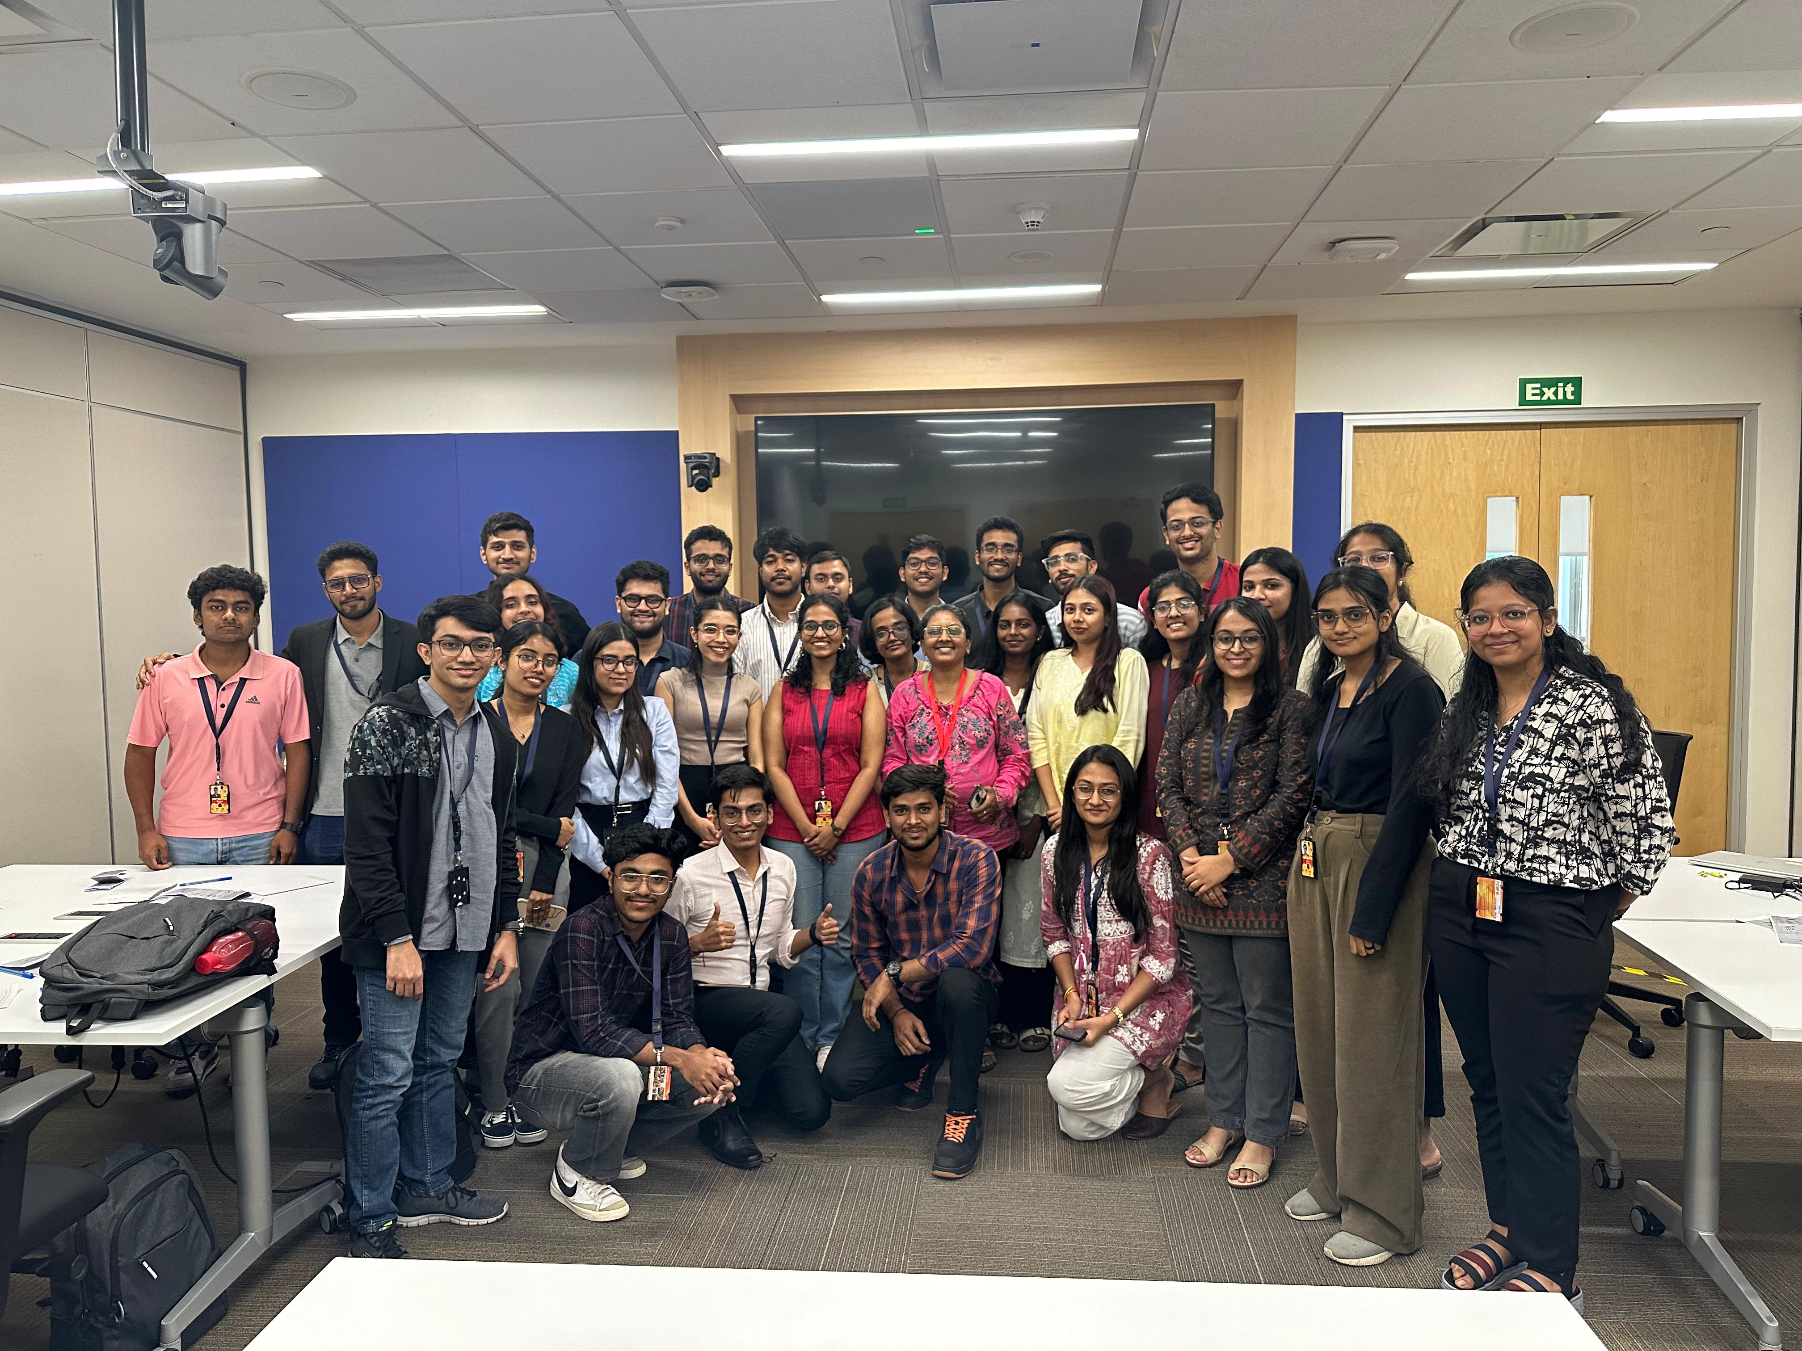
Learning is also Fun!
My soft skills learning experience was truly excellent. We delved into essential areas such as presentation techniques, professional etiquette, and effective speaking skills, which have significantly enhanced my communication abilities. Additionally, we explored Agile methodology, the Software Development Life Cycle (SDLC), and the role of a Business Analyst, providing a comprehensive understanding of both technical and interpersonal skills. This well-rounded approach has equipped me with the tools needed to excel in various professional settings.

Slide 25

Summary
Learnt presentation skills, etiquettes, growth and fixed mindset, roleplays on stake holders
Unit testing, Integration testing, DBMS
Agile model on azure devops would be extremely helpful in developing the case studies we will get next week.

Slide 26
Thank You

